Slide 1
CLINICAL FEATURES OF IRIDOCYCLITIS
DR. VIVEKANAND U

Slide 2
What is Uvea?
Literally

Slide 3
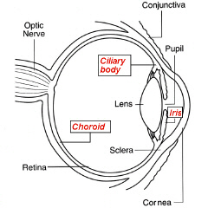
Anatomy
Iris
Ciliary body
Choroid

Slide 4
UVEITIS
Uveitis, a term correctly used to describe inflammation of the uveal tract (iris, ciliary body, choroid) alone, in reality comprises a large group of diverse diseases affecting not only the uvea but also the retina, optic nerve and vitreous.

Slide 5
Classification
IUSG classification
SUN group classification

Slide 6
CLASSIFICATION
CLINICAL
Acute / Chronic / Recurrent
ANATOMICAL
Anterior / Intermediate/ Posterior/ Panuveitis
MORPHOLOGICAL
Granulomatous / Non-granulomatous
AETIOLOGICAL

Slide 7
Aetiological classification (IUSG)
Traumatic
Surgical - IOL related uveitis
Non surgical
Toxic
Chemical
Drug induced - rifabutin
Masquerade syndrome

Slide 8
Aetiological classification (IUSG)
Infectious
Bacterial, fungal, viral, protozoal
Non Infectious
Known systemic association - VKH
Not known systemic association - Serpiginous choroiditis

Slide 9
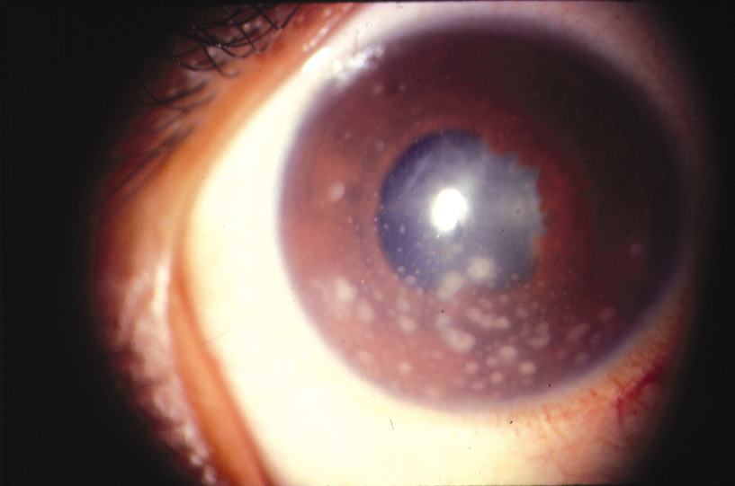
Non granulomatous vs Granulomatous
Onset - well defined
Course - acute
Injection - +++
Pain - +++
KP's - fine
Iris nodules - absent
Posterior segment - rarely involved
Onset - insidious
Course - chronic
Injection - +
Pain - +
Iris nodules - +
KP's - mutton fat
Posterior segment - commonly involved

Slide 10
ANATOMIC CLASSIFICATION
Panuveitis

Slide 11
The SUN Working Group Anatomic Classification of Uveitis
Type | Primary site of inflammation | Components
Anterior uveitis | Anterior chamber | Iritis, Iridocyclitis, anterior cyclitis
Intermediate uveitis | Vitreous | Pars planitis, Posterior cyclitis, Hyalitis
Posterior uveitis | Retina or choroid | Choroiditis (Focal, multifocal or diffuse) Chorioretinitis, Retinochoroiditis Retinitis, Neuroretinitis
Panuveitis | AC, Vitreous, Choroid or Retina

Slide 12
The SUN Working Group Descriptors of Uveitis
Onset
Sudden
Insidious
Duration
Limited <3 months duration
Persistent >3 months duration

Slide 13
The SUN Working Group Descriptors of Uveitis
Course
Acute
Episodes characterized by sudden onset & limited duration
Recurrent
Repeated episodes separated by periods of inactivity without Rx > 3 months in duration
Chronic
Persistent uveitis with relapse in < 3 months after discontinuing treatment

Slide 14
Acute non granulomatous anterior uveitis due to collagen disease
COMPLETE CLASSIFICATION

Slide 15
Symptoms of Anterior uveitis
Pain
Redness
Photophobia
Dimness of vision
Lacrimation

Slide 16
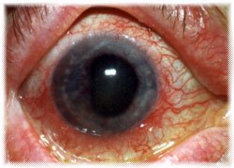
Signs of anterior uveitis
CONJ - CCC
CORNEA -
Keratic precipitates
Fine
Mutton fat
Fresh
Old

Slide 17
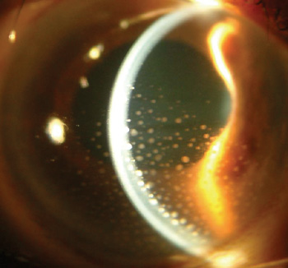
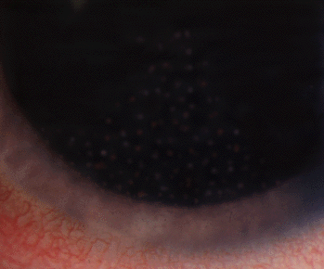
KP’S
Aggregates of inflammatory cells on the endothelial surface of the cornea
ARLT”S TRIANGLE
BASE DOWN TRIANGLE ON THE INF PART OF CORNEA
CONVENCTION CURRENTS IN AQUEOUS,GRAVITATION OF PARTICLES.

Slide 18
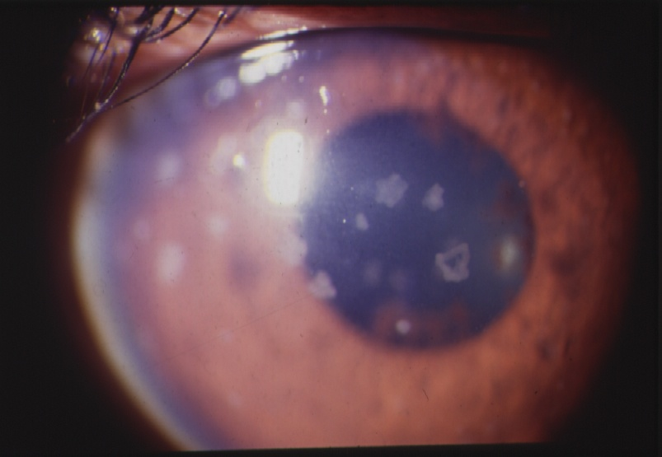
TYPE OF KP’S
Mutton fat-larger, greasy
white,smoothly round
old-pigmented

Slide 19
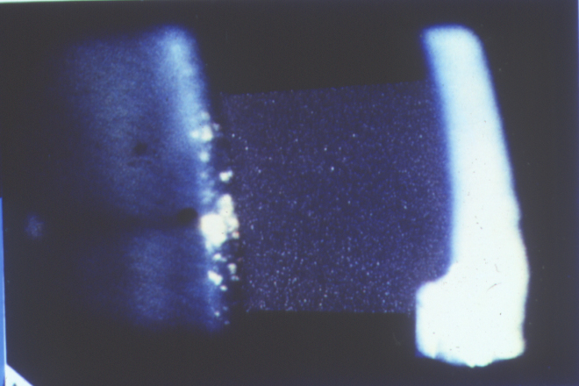
Anterior chamber
FLARE
Breakdown of blood aqueous barrier
Protein transudation from the iris & ciliary vessels produce opalescence of the aqueous .
Slit beam (1mm x 1mm) with maximum intensity is obliquely aimed across the anterior chamber

Slide 20
The SUN Working Group Grading Scheme for Anterior Chamber Flare
Grade
Description
0 | None
1+ | Faint
2+ | Moderate (iris &lens details clear)
3+ | Marked (iris &lens details hazy)
4+ | Intense (fibrin or plastic aqueous)

Slide 21
Anterior chamber
CELLS
Collection of floating inflammatory cells in the anterior chamber
Primarily lymphocytes & also neutrophils
Indicates active inflammation.

Slide 22
Kimura’s grading of AC cells :
Trace | 0-4 cells
1+ | 5-10 cells
2+ | 11-20 cells
3+ | 21-50 cells
4+ | > 50 cells

Slide 23
The SUN Working Group Grading Scheme for Anterior Chamber cells
Grade
Cells in Field (1mm by 1mm slit beam)
0 | <1
0.5+ | 1-5
1+ | 6-15
2+ | 16-25
3+ | 26-50
4+ | >50

Slide 24
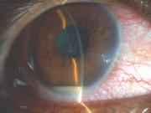
Hypopyon
Collection of inflammatory cells that settle down in the anterior chamber.
Ankylosing spondylitis
Behcet’s disease
Infection
Lens induced uveitis
Malignancy

Slide 25
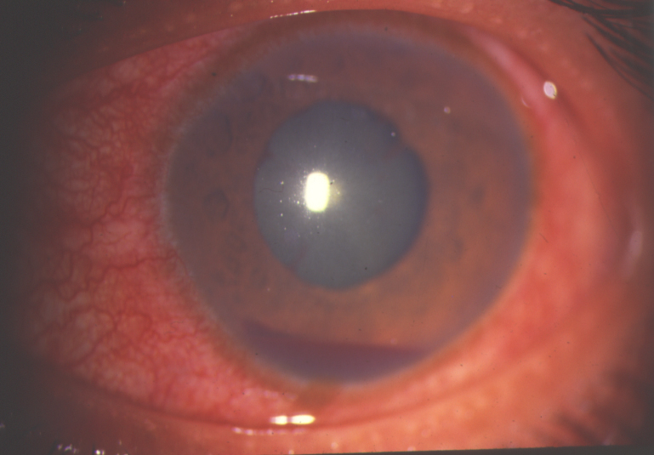
Hyphaema
Collection of RBCs that settle down in the anterior chamber.
Viral uveitis
Trauma
Malignancies
Fuchs Heterochromic
iridocylitis
Chronic uveitis with rubeosis
Any severe uveitis

Slide 26
Iris
Posterior synechiae
adhesions between iris & lens capsule.
Inflammatory mediators produce fibrin deposits & fibroblast proliferation.
Indicates chronic or recurrent inflammation.
Most are located at the pupillary border.

Slide 27
Festooned pupil
Multiple posterior synechiae with the application of mydriatics causes the intervening normal circle of the pupil to dilate.

Slide 28
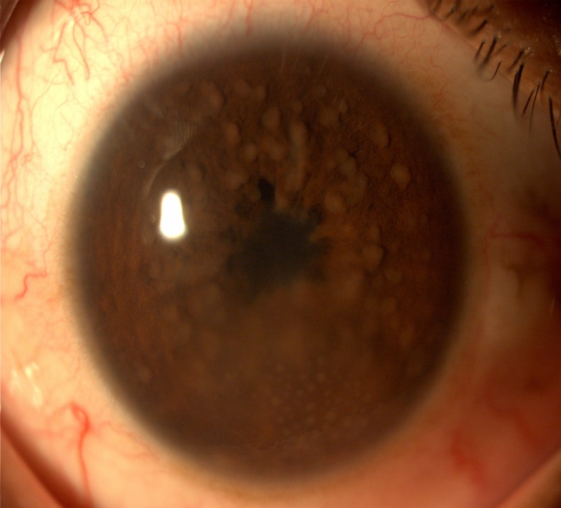
Iris nodules
Accumulation of inflammatory cells on the iris surface.
Koeppe’s nodule – pupillary border.
Busacca’s nodule – iris surface.
Berlin’s nodule - angle

Slide 29
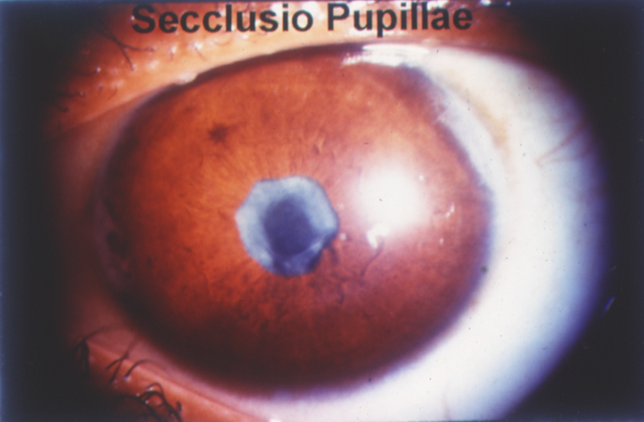
Seclusio pupillae
In severe cases of plastic or recurrent iritis, whole pupillary margin is attached to the lens capsule.
Aqueous collects behind the iris and iris bows forwards like a sail – iris bombe.
Angle becomes obliterated by adhesion of peripheral iris to posterior surface of the cornea – PAS.
IOP raises.

Slide 30
Occlusio pupillae
The extensive exudation organise across the pupillary area to form a film of opaque fibrous tissue – occlusio pupillae.

Slide 31
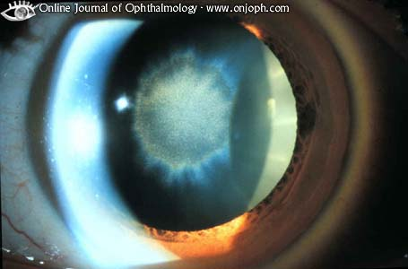
LENS
Complicated cataract
VITREOUS
Opacities – leucocytes, coagulated fibrin & exudates

Slide 32
INTRA OCULAR PRESSURE
Raised due to
ACTIVE STAGE
Hypertensive iridocyclitis
LATER STAGE
Secondary glaucoma (pupillary block/PAS)
Reduced due to
Atrophy of ciliary body Hypotony
Phthisis bulbi

Slide 33
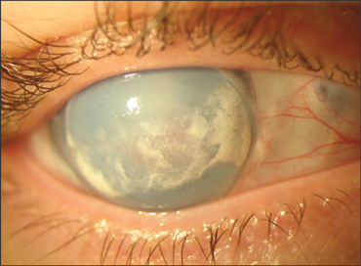
SEQUELAE OF CHRONIC ANTERIOR UVEITIS
Band keratopathy
Iris atrophic patches
Miotic pupil
Complicated cataract
Cyclitic membrane
Detachment of ciliary body
Pthisis bulbi.

Slide 34
Macular edema major cause of severe visual impairment
Cataract is common in chronic uveitis and its treatment with corticosteroids.

